Slide 1
Non-committing: Waiting for good conditions

Slide 2
Problem structure
Now, there are multiple possible effort states. In each effort state, there is a different amount of effort required to finish the task. There is an action-independent transition dynamics between these states.
As before, there are actions to work or shirk, a delayed reward/ punishment on passing/ failing and an immediate reward for shirking
In the simulations, I use 3 efforts states (easy, medium and hard with efforts: -0.2, -0.5, -1.0)

Slide 3
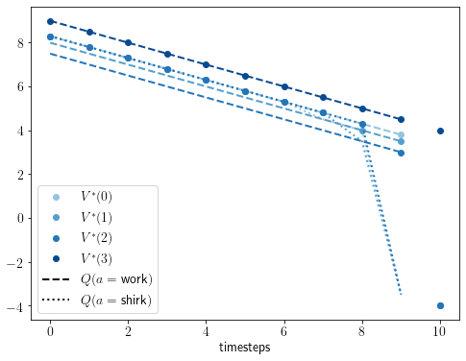
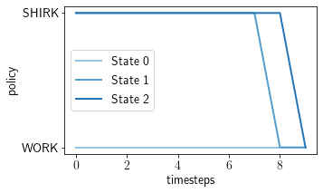
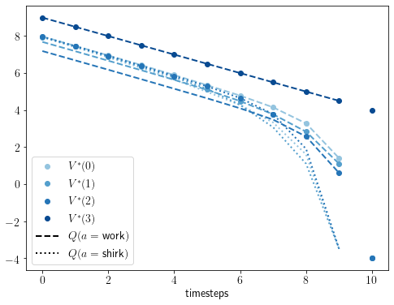
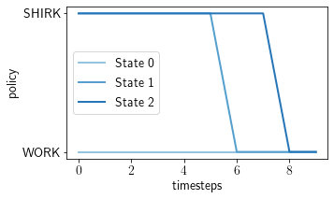
It is optimal to wait for the easy state to emerge which is guaranteed (until the last two time steps) with deterministic transitions and efficacy=1. When efficacy = 0.7, still WAIT but not as long, to improve chances of completing. So planned procrastination to get better conditions. Here, it is known when the better conditions will come given current state.
Cyclic and deterministic dynamics:
Efficacy = 1.0:
P(s_t,s_t+1) | easy | med. | hard
easy | 0 | 1 | 0
med. | 0 | 0 | 1
hard | 1 | 0 | 0
Discount = 1.0,
reward(pass, fail, shirk) = 4, -4, 0.5
Efficacy = 0.7:

Slide 4
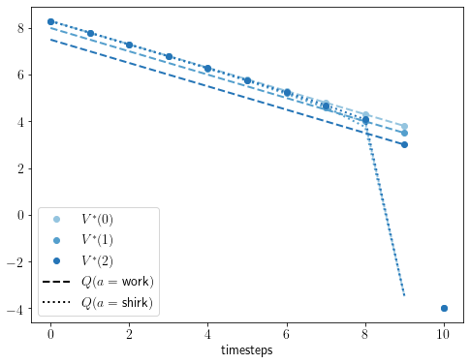
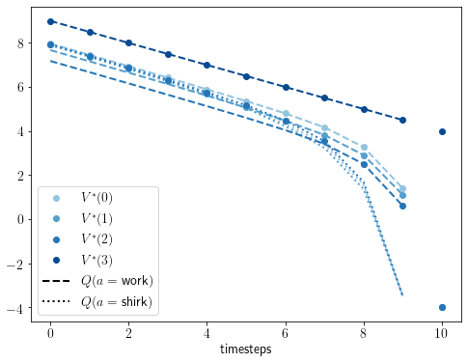
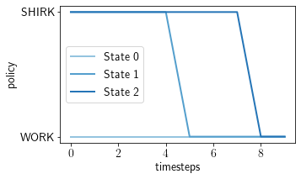
When the transitions are probabilistic, still wait for easy state but not as much as before, to improve chances of completion. Notably, in this case, the agent doesn’t know when it will work because when the easy state will be reached is unknown. However, there is a commitment to the latest possible time that the agent will wait.
Cyclic but probabilistic dynamics:
Efficacy = 1.0:
P(s_t,s_t+1) | easy | med. | hard
easy | 0.2 | 0.6 | 0.2
med. | 0.2 | 0.2 | 0.6
hard | 0.6 | 0.2 | 0.2
Efficacy = 0.7:

Slide 5
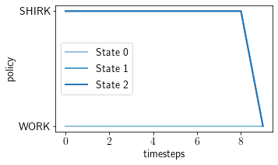
Why start before in medium state than hard state? Is it because medium state has higher probability of going to hard state or because task is easier in medium than hard? Both! When dynamics changed without changing efforts required, no longer start earlier in med state (when efficacy = 1.0). With efficacy = 0.7, start earlier in med state because it costs lesser (but not as early as the previous case)
Different cyclic dynamics (e-h-m instead of e-m-h):
Efficacy = 1.0:
Efficacy = 0.7:
P(s_t,s_t+1) | easy | med. | hard
easy | 0.2 | 0.2 | 0.6
med. | 0.6 | 0.2 | 0.2
hard | 0.2 | 0.6 | 0.2

Slide 6
Instead of cyclic transitions consider monotonic ones where H-M-E transitions are most probable. This can correspond to improving skill in time that reduces difficulty. The policy patterns are very similar to the cyclic case (with E-H-M-E). Similar mechanism plays out. Why? Here too, there is higher probability of medium going to easy, so no need to start too early in medium (can afford to wait for easy). Only difference is, value of easy is more here because less prob of going to hard
Efficacy = 1.0:
Monotonic dynamics
P(s_t,s_t+1) | easy | med. | hard
easy | 0.6 | 0.2 | 0.2
med. | 0.6 | 0.2 | 0.2
hard | 0.2 | 0.6 | 0.2
Efficacy = 0.7:

Slide 7
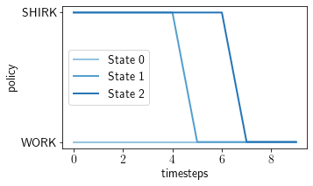

Stickier probabilities: earlier, the probability of reaching another state was high(0.6+0.2). What if probabilities are stickier? Similar patterns but start earlier in medium and hard states because lower probability of reaching easy. With efficacy = 1.0, still wait till the end.
Efficacy = 0.7:
P(s_t,s_t+1) | easy | med. | hard
easy | 0.8 | 0.1 | 0.1
med. | 0.2 | 0.7 | 0.1
hard | 0.1 | 0.2 | 0.7
Efficacy = 0.7:
Efficacy = 1.0:
P(s_t,s_t+1) | easy | med. | hard
easy | 0.7 | 0.1 | 0.2
med. | 0.2 | 0.7 | 0.1
hard | 0.1 | 0.2 | 0.7

